Slide 1
AMYLOIDOSIS
Definition:
A condition in which normally soluble proteins become insoluble and are deposited in extracellular spaces of various organs or tissues, disturbing the normal function.
These insoluble proteins(misfolded proteins )are called amyloid .

Slide 2
More than 20 different proteins can aggregate to form the amyloid .
Amyloid is composed of nonbranching fibrils, 7.5 to 10 nm in diameter, each formed of β-sheet polypeptide chains that are wound together.

Slide 3
The dye Congo red is commonly used to identify amyloid desposits in tissues. Congo red dye binds to the amyloid fibrils and produces a red-green birefringence.

Slide 4
Pathogenesis of Amyloid Deposition
1- AL (amyloid light chain) protein
Is produced by plasma cells and is made up of complete immunoglobulin (Ig) light chains
For e.g. monoclonal B-cell proliferation (Plasma cell myeloma)

Slide 5
2- AA (amyloid-associated) protein
Is a protein derived from a larger serum precursor called serum amyloid-associated protein (SAA) that is synthesized in the in the liver.
Is associated with chronic inflammatory disorders .

Slide 6
3- Aβ amyloid (Amyloid beta)
Aβ protein is derived from a much larger transmembrane glycoprotein called amyloid precursor protein (APP) by the action of proteolytic enzymes ; alfa & beta secretase.
Aβ circulates in the plasma, CSF & brain interstitial fluid

Slide 7
Aβ is found in the cerebral lesions of Alzheimer disease. Plays a central role in the development of Alzheimer disease.

Slide 8
4- Amyloid transthyretin (ATTR)
(TTR)is a normal serum protein that binds & transport thyroxin and retinol.
Mutations in the gene encoding transthyretin result in the production of a protein that aggregate and form amyloid deposits.
The resultant diseases are called familial amyloid polyneuropathies.

Slide 9
5- Aβ2- Microglobulin : affect patients on long term hemodialysis .
A β2m is structurally similar to normal β2m . because it is not efficiently filtered through dialysis membrane and deposits in synovium , joints and tendon sheaths .

Slide 11
Effects of Amyloidosis
Histologically, the amyloid deposition is always extracellular and begins between cells, often closely adjacent to basement membranes.
The clinical manifestations of amyloidosis depends on the organ involved

Slide 12
Kidney
Amyloidosis of the kidney is the most common and most serious
The amyloid deposits are found principally in the glomeruli

Slide 13
At first there is focal deposits within the mesangial matrix and diffuse or nodular thickenings of the basement membranes of the capillary loops. With progression , the deposition involves the capillary lumina and eventually leads to total obliteration of the vascular tuft.

Slide 17
Liver
Massive enlargement (as much as 9000 gm)
Extremely pale, grayish, and waxy on both the external surface and the cut section
Histologically , amyloid deposits first appear in the space of Disse (between hepatocytes ) and then progressively enlarge to encroach on the adjacent hepatic parenchyma and sinusoids .

Slide 18
The trapped liver cells undergo compression atrophy and are eventually replaced by sheets of amyloid
*Normal liver function may be preserved even in the setting of severe involvement.

Slide 19
Heart
Amyloid deposits are typically found throughout the myocardium , beginning Between myocardial fibers and
eventually causing their pressure atrophy leading to cardiomyopathy with heart failure .

Slide 21
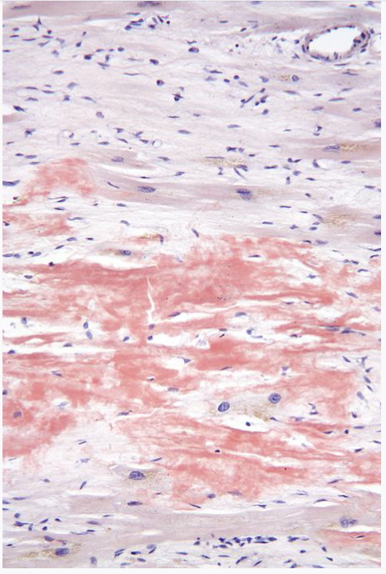

Slide 23
Amyloidosis of the adrenals, thyroid, and pituitary is common but without apparent disturbance of function
Nodular depositions in the tongue may produce macroglossia.
CNS : Amyloid β protein associated with Alzheimer disease

